Slide 1
Assignment
Bubble Sort

Slide 2
DEFINITION OF BUBBLE SORT
Bubble sort is sort algorithm that compares two adjacent elements and swaps
them until they are in the intended order.

Slide 3
DEFINITION OF BUBBLE SORT
Just like the movement of air bubbles in the water that rise up to the surface, each element of the array move to the end in each iteration. Therefore, it is called a bubble sort.

Slide 4
DISADVANTAGES
Disadvantages of Bubble Sort Algorithm
The main disadvantage is the amount of time it takes. It is highly inefficient for large data sets, with a running time of O(n2).
Furthermore, the presence of turtles can significantly slow the sort.

Slide 5
ADVANTAGES
Besides the memory that the array or list occupies, the bubble sort requires very little memory.
The bubble sort is made up of only a few lines of code.
With a best-case running time complexity of O(n), the bubble sort is helpful in determining whether or not a list is sorted. Other sorting methods frequently cycle through their entire sorting sequence, taking O(n2) or O(n log n) time to complete.
The same is true for data sets with only a few items that must be swapped a few times.

Slide 6
BUBBLE SORT COMPLEXITY
Time Complexity
Best | O(n)
Worst | O(n²)
Average | O(n²)
Space Complexity | O(1)
Stability | Yes

Slide 7
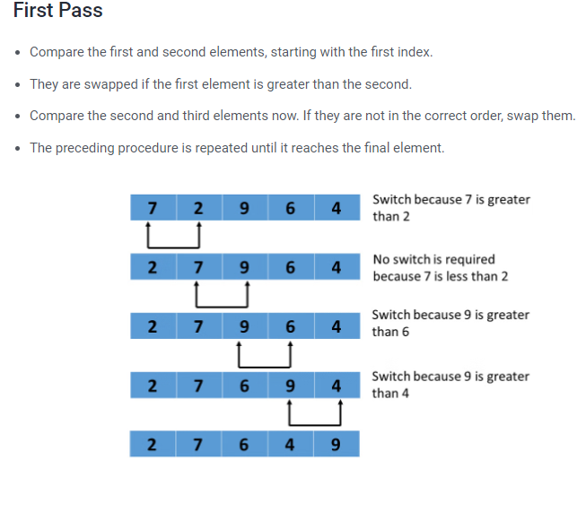

Slide 8
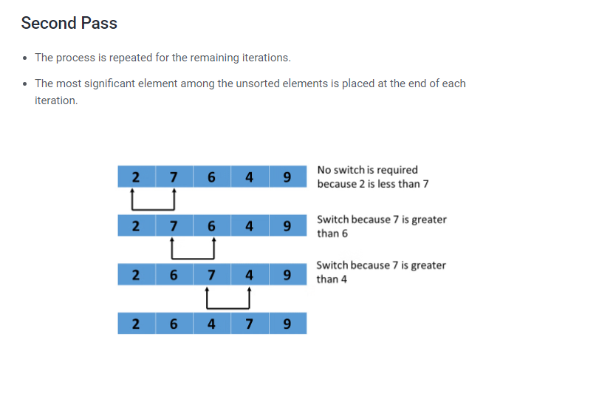

Slide 9
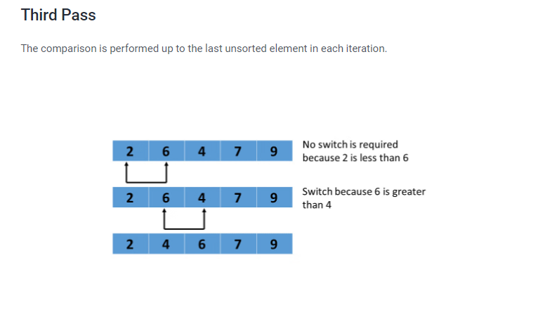

Slide 10
